Slide 2
MAXimum WELLness Travel
Is a travel agency that helps others find
Places to relax
Places to explore

Slide 3
MAXimum WELLness
Many are too busy to research their own travel plans.
Working many hours
Taking care of children
The site care provide some recommendations
New Year’s
Spring break

Slide 4
Stakeholders
Employees
Customers
Destination
Government
Suppliers
Domestic Airlines

Slide 5
Stakeholders
Destination Stakeholders
Tourism is the effect
Government
Local government receives more tourism
Can lead to more growth
Suppliers
More demand for items
Domestic Airlines
A travel method are the Airliners
More travelers

Slide 6
Audience
Families, Couples, Single individuals
Gender isn’t as much a concer
Age is a different matter

Slide 7
Audience
General Audience
Any Gender
From age 18 – 65+

Slide 8
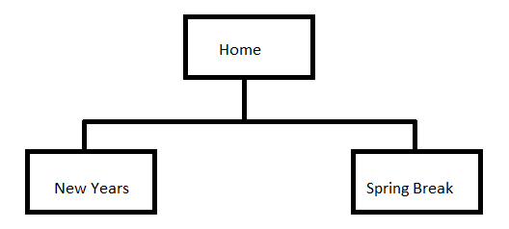
Sitemap
Three Sites
Home
New Years
Spring Break

Slide 9
Prototype Site
Three Sites
Home - Live
New Years - Live
Spring Break - Live

Slide 10
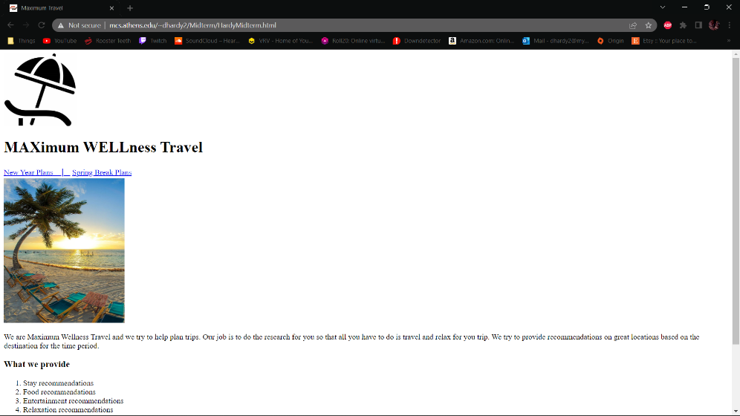
Home
Accessibility Alerts
Header levels
Table issues
Is Validated

Slide 11
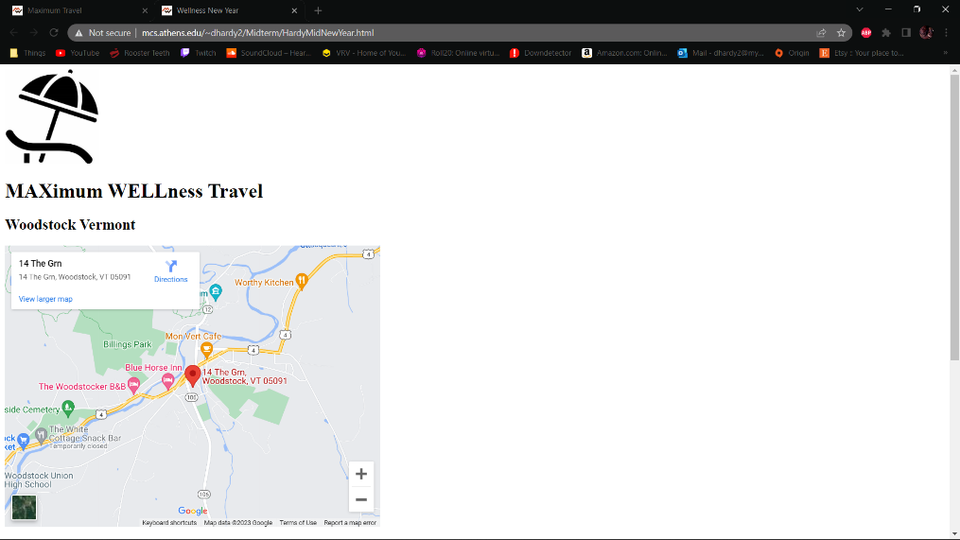
New Year’s
No Accessibility Alerts
Is Validated

Slide 12
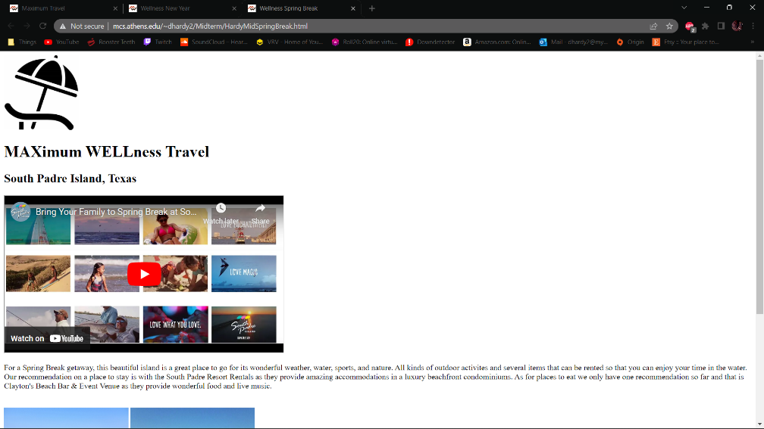
Spring Break
Accessibility Alert
No captions for YouTube video
Is Validated

